Slide 1
Empowering Firefighters:
A Practical Approach to CRR
Notes:
Introduction: Chris Walker Fire Marshal City of Wilmington, NC FD & Wendy Giannini-King CRR Coordinator of the City of Wilmington, NC FD
Why we decided to put this session together
It feels like from an operational perspective, gone are the days of going out and training with your company. Who has heard, “we cannot do X because we have to do Y?” (Proficiency drills, BSS, PIP’s, Monthly Competencies, EMT…..the list goes on.

Slide 2
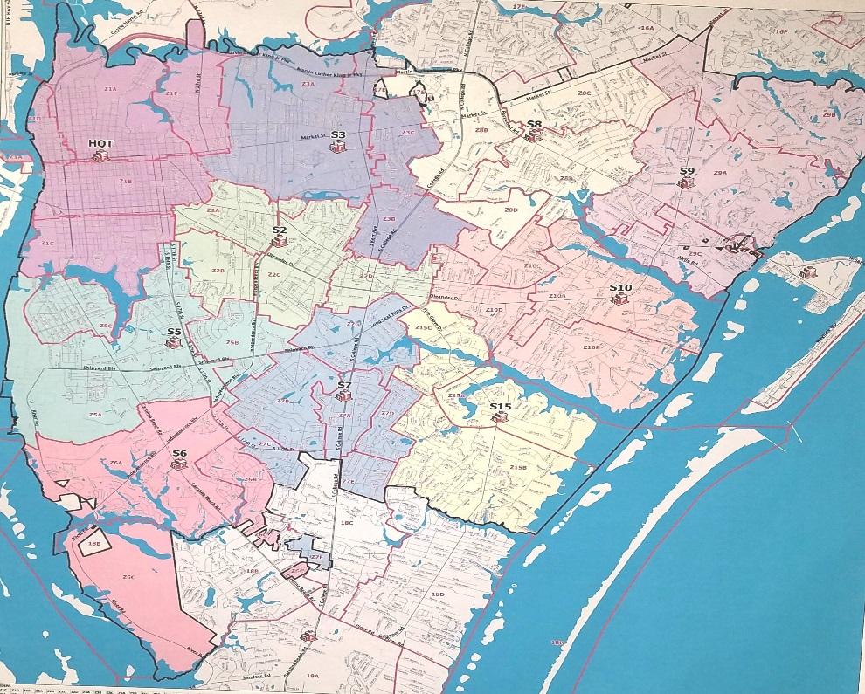
You are here

Slide 3
Wilmington Fire Department in a Nutshell Accredited Agency since 2014
115,261 Population
15 Fire Apparatus
10 Fire Stations
189 Fire Suppression Personnel
14,010 Total Incidents
52% EMS Calls 48% Fire Calls
Used 8,293 gallons of diesel fuel
Since August of 2018:
68 PIP 41 BSS
2,639 hydrant inspections
FMO in 2018:
1,106 Plan Reviews
2,951 Completed Occupancy Inspections
1,650 Construction Inspections

Slide 4
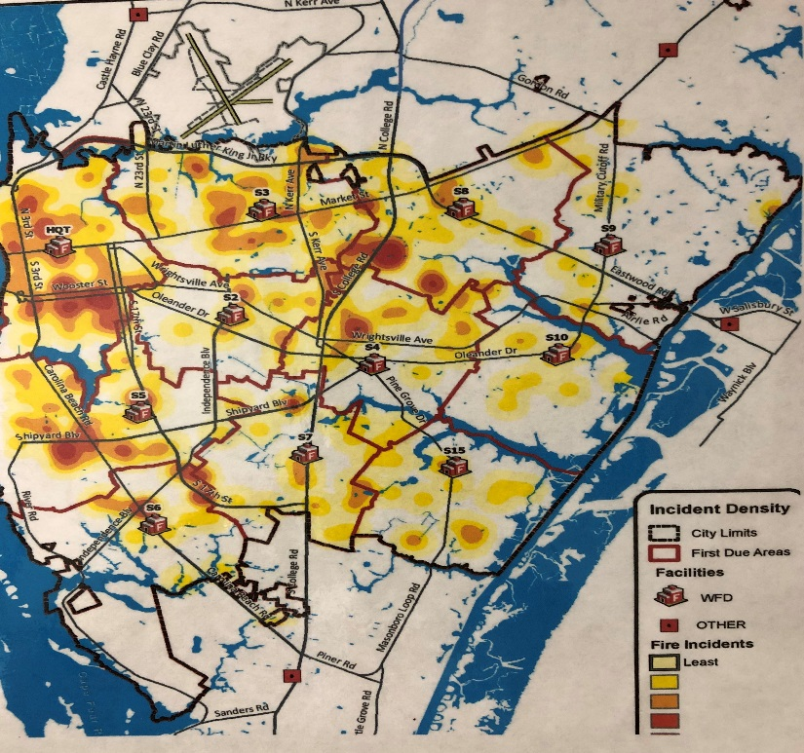
We know where our problems are

Slide 5
Where we were...
Chief Frank Blackley
The WFD CRR Video. Who has seen it?
https://youtu.be/3McRG2lOkJM?t=1118
Systemic Programs vs. Response Area Specific Programs
Notes:
Chief Blackley our roots go back to 2008
No buy-in constant back and forth between admin & FF
Rags Example:

Slide 6
Where we are...
Transition - Ops infusion into Fire Marshal’s Office
Growing Pains
Staff Reduction….WTF?
Think of different ways to accomplish the goal!

Slide 7
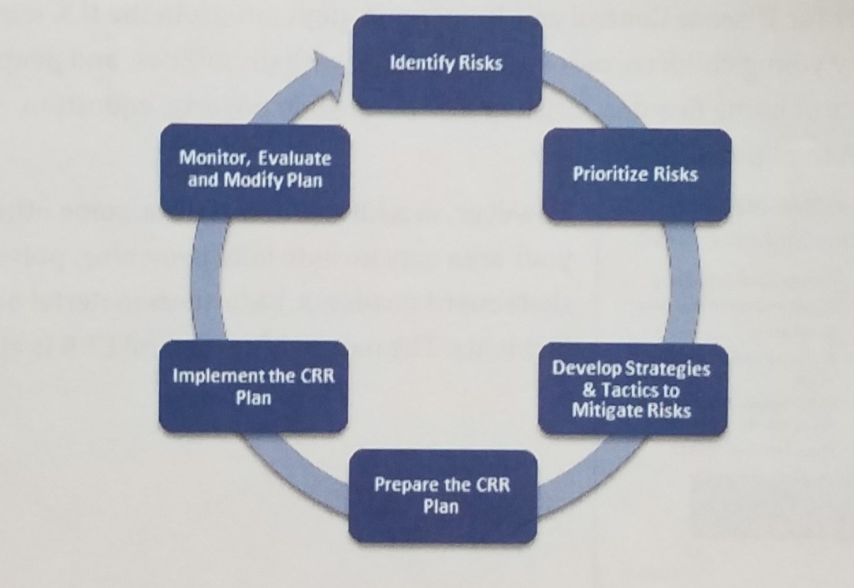
What matters to you?(Simple Risk Assessment)
Notes:
Identify the risks and prioritize the risks are the easy first steps for the firefighters.
Down and Dirty boots on the ground risk assessment (refer to handout)
We let our data analyst and admin do the heavy lifting for the firefighters

Slide 8
Willoughby Park Subdivision
60% reduction in 911 smoke alarm calls
(over a 3 year period)
From: Mike Kolotello
Sent: Monday, November 20, 2017 5:43 PM
To: Wendy Giannini-King
Subject: Re: door hangers
We had a good time. most were not home but we did get to talk to a few people. They asked questions and got information. We will find out over the next week when/if they call us/you. We ran out of the hangers. MORE PLEASE!!!!!. Willoughby Park was canvassed. We have two other areas where we know they are 10 plus years old and rentals and owned. See you next time.
Captain Kolotello
________________________________________

Slide 9
Cape Cottages
From: Jill Rhoad
Sent: Mon 3/5/2018, 4:05 PM
To: Wendy Giannini-King
We manage 150 rentals and 5 HOAs locally. We have had a substantial increase in grease fires in the last 48 months. I would like to discuss with you options on training, getting people to come, possible administering a fire safety test then requiring education. My office hours are 9-4 monday to friday. I could meet with you at your office or you can come here. I have spoken with James Merritt about this issue as well on my inspections.
Jill Rhoad
Cape Cottages/Association Management of Wilmington
3/ 2016 -3/2018 = 5
structure fires (4 were cooking related)
100 % reduction in 12 mos.

Slide 10
UNCW
Date Range | Non-EMS Calls | Residential Students
July 1, 2007-June 30, 2012 | 1,208
July 1, 2012 - June 30, 2017 | 1,181
Notes:
Population on the rise by a minimum of 200 students annually.

Slide 11
Where we are going...
Increased “Buy-In”
Recruit Academy
Culture change, “You can make the difference”
Constantly evolving, CRR is a moving target

Slide 12
What does your current CRR program look like?
Who sets the standards for the program?
Is it systemic?
What kind of “buy-in” do you have?
Notes:
Do you give anyone else autonomy or do you as the FIRE Chief say this is what we are going to do.
Compare to the Report Out Session, who reports the data vs. who is the data.

Slide 13
Does your current program check a box or make a difference?
Nothing wrong with “checking the box”
Most successful people / programs do not follow traditional models & methods
Who is your CRR program going to benefit? Internal vs. External Stakeholders?
Find balance
Notes:
We understand in times of FIRE being the lowest percentage of emergency response and politicians want justification for staffing, DATA drives everything

Slide 14
The sky is the limit (within budget)
Notes:
Community Partners:? $?

