Slide 1

Measuring and Reporting Your Agency’s Real Value to the Community

Slide 2
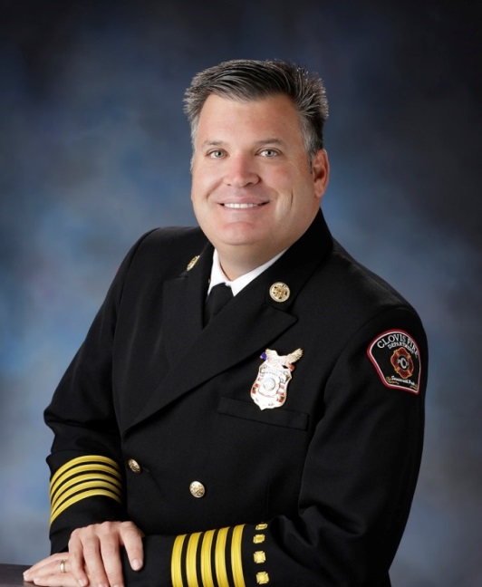
John P. Binaski MS, EFO, CFO
*
Over 28 years of fire service experience.
Currently the Fire Chief for the City of Clovis (CA).
Previously a Division Chief for the City of Tulare (CA).
Board Member for League of CA Cities
Experience as a Fire Technology Coordinator and certified as a Master Instructor.
Serves as a Peer Assessor for the Commission on Fire Accreditation International.
Clovis FD has been an accredited fire agency for 16 consecutive years.
Notes:
I have just completed my second year as a new fire chief – first fire chief position.
I have had the opportunity to see first hand good and bad fire chiefs. I took things away from all of them, especially some things not to do and we will discuss some of these during this presentation.
Your goal should be to find a good mentor and sounding board right away. They will help you to know if you are ready to be a fire chief, ways to prepare, and assist you once you become a fire chief.

Slide 3
Objectives
The importance of finding Outcomes that matter
How to discover the Outcomes that matter within your community
Common mistakes in trying to measure and report agency performance
Define Activities, Outputs and Outcomes and how they differ as they relate to emergency services
How to more effectively communicate those Outcomes that matter to your community

Slide 4



Performance Management Initiatives

Slide 5
95 Cities Participate (2,100 measurements)
16 Cities report on Fire/EMS related measurements (1,300)
7 agencies include an outcome measurement (12)
  Civilian fire deaths/injuries
  Firefighter injuries
  Cardiac Survival %

Slide 6
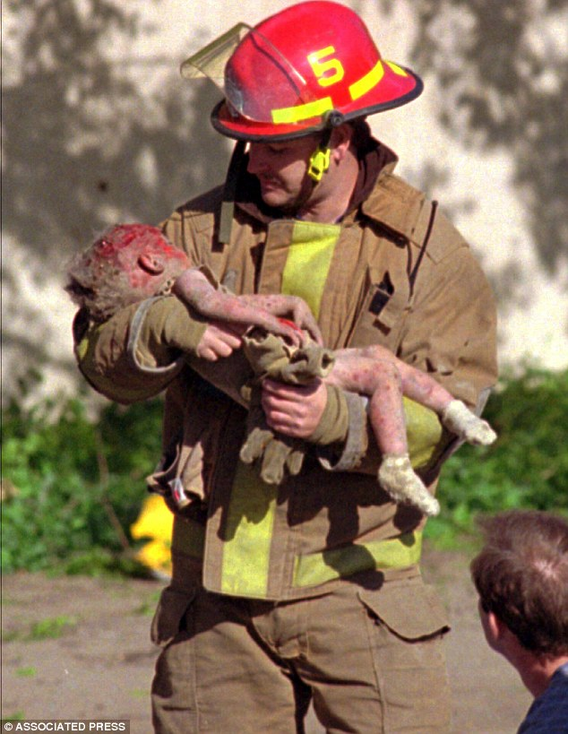
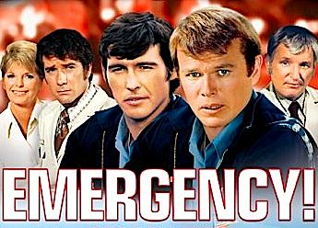
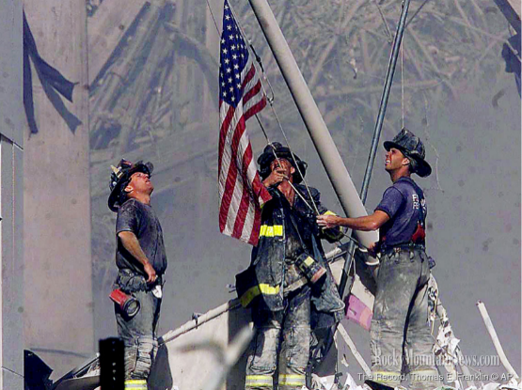
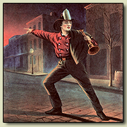
Ask your citizens if they like the Fire Department?

Slide 7
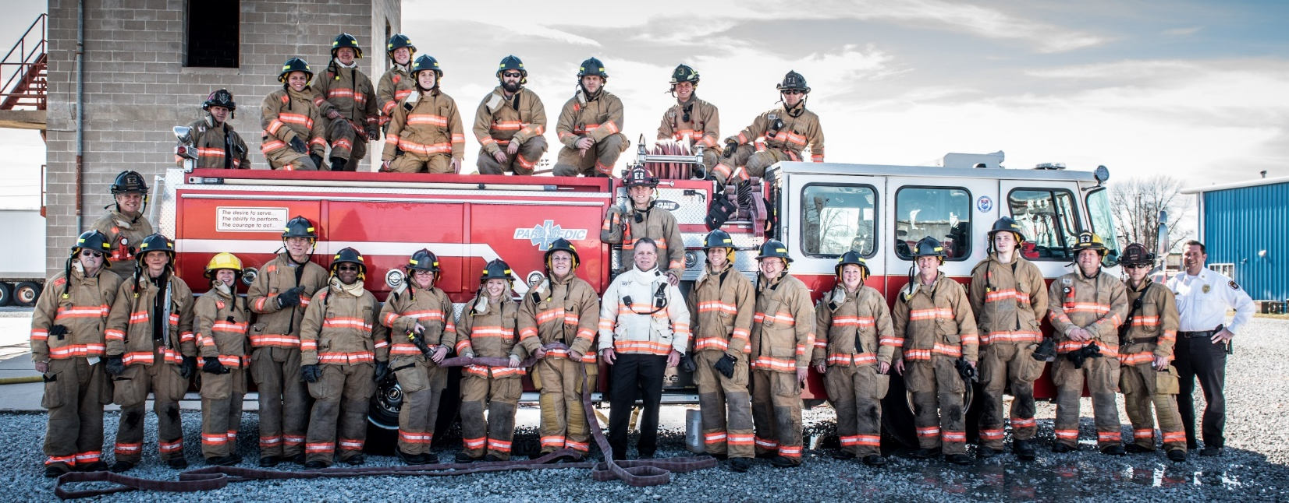
Community Stakeholder Task Force

Slide 8
Advantages of involving your community
They will have a better-than-average understanding of how things works behind the scenes and why we do them the way we do
They can be advocates for your resource needs
They can market you better than just about any other media source
Ambassadors of Good Will

Slide 9

Survey Says……
Show Up Quick
Solve My Problem
Be Nice
Don’t Cost Me a Lot of Money!!

Slide 10
Findings (Outcomes) that Matter
Saving lives (people and pets)
Saving people (and pets) from injuries (burns, entrapment, lacerations, falls, etc.)
Preserve property and property value (keep business open for business)
Maintain quality of life (blight, displacement, tax base, etc.)
Keep insurance rates low
Keep cost of service low

Slide 11
*
  Some Common Mistakes in Trying to Measure and Report Service Levels

Slide 12
Calls for Service
*
Notes:
John. This tells you nothing really other than how many times the tones sounded. What does this really tell us? Running a few more calls, yes but what is the outcome of the calls. In some agencies, the busier they get, the faster and better they get because its now more of the focus for the day. Some agencies might have a declining number of calls and yet have worse response times because of calls that come in stacked.

Slide 13
Calls for Service vs. Workload
*
Notes:
This is slightly more sophisticated. Here an agency is showing the difference between running a number of incidents versus the number of responses that were needed to meet the needs of the call. i.e. 5 units might respond to the same fire call. It would then be 1 call for service but 5 responses. Also, remember to account for all the calls for service when determining workload, not just the calls within the first due area. Example, first due units get the NFIRS report and that might count as one incident, but you may have had 2 to 5 other units responding to the same call. YET, this is just a simple response. This does not explain how much work was done once you got to the incident.

Slide 14
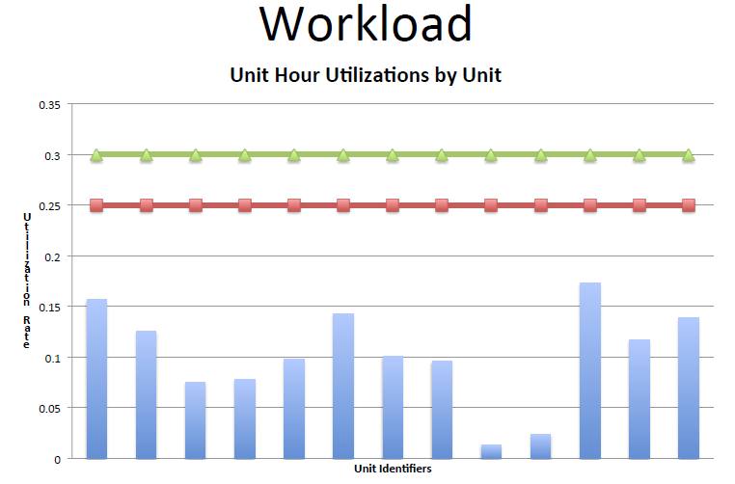
*
Workload
Notes:
One of the best measurement is what is a day in the life of a firefighter look like? How busy are they based on a percentage of their available hours?

Slide 15
*
How Busy is Too Busy?
Unit | Responses | Commitment Factor
Engine 1 | 3316 | .21
Engine 2 | 1404 | .20
Engine 3 | 3533 | .17
Truck 4 | 2966 | .19
Engine 5 | 3646 | .22
Engine 6 | 2289 | .12
Engine 7 | 1977 | .19
Engine 8 | 3194 | .17
Truck 10 | 961 | .15

Slide 16
Calls for Service
*
Percentage Growth
Notes:
John. Maybe you are running too many of the wrong type of call. Maybe your population is primarily elderly or a demographic that needs lots of extra services? Will this change over time? I suspect this will be the pattern for most agencies over the coming years.

Slide 17
Calls for Service 80/20
*
Notes:
Some agencies just show EMS calls versus all other types of calls. Again, what does this really tell you? What is an MVA? Is it medical, is it a rescue, or how else will you classify it? Some agencies use over simplified graphs which can create some urban myths such as; 80% of your calls are EMS so why do we need to have all those big fire trucks and so many firefighters?

Slide 18
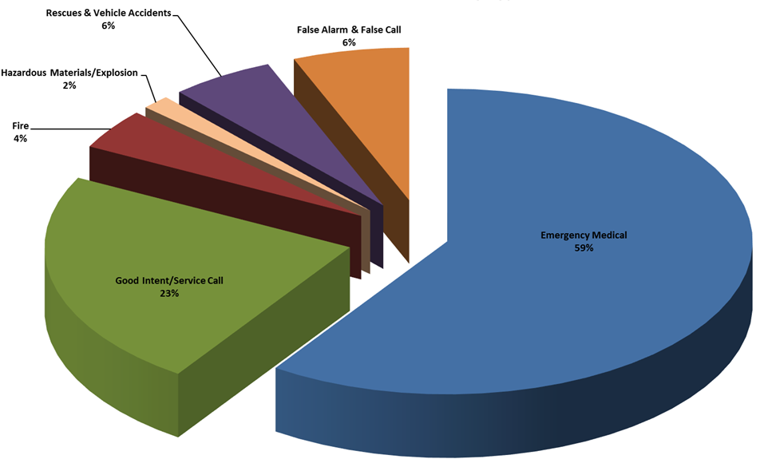
Calls for Service By Type
*
Notes:
Here is an example where the “80% Medical” can be illustrated graphically to better represent the variety of calls you are truly handling. Same data but shows Rescue Calls and other types of calls that might have been mis-categorized as EMS as their own category.
Now we describe this as number of calls for service that fall into a category…. .NOT Workload.

Slide 19
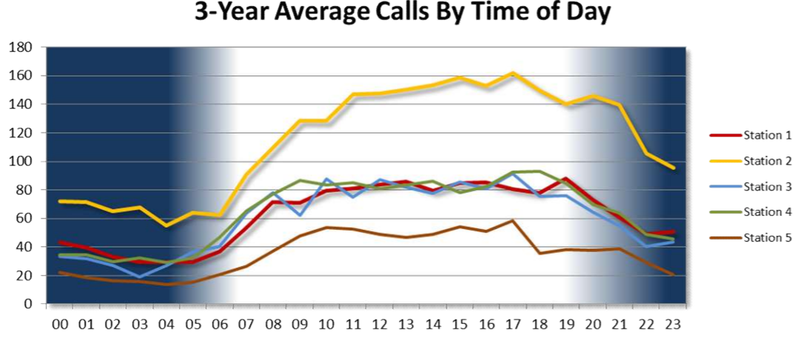
*
Notes:
Time of day can be slightly interested but I suspect every agency in the nation has a pattern similar to this (maybe not bedroom communities). Here station 2 looks very busy but compared to what?

Slide 20
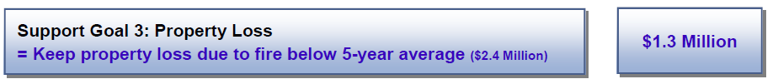
What is wrong with this measurement?

Slide 21
The Old “Firefighters Per One Thousand” Story
*
“Firefighters per 1,000” or “Firefighters per Capita”
  The only direct correlation between FF’s per Capita and an outcome is an increase in the budget. REFERENCE: Smarter, Faster, Cheaper. IBM Global Business Services 2011
  There are no studies to correlate this to any important fire service outcomes (i.e., reduction in injury rates to civilians or FF’s, less fire loss, higher EMS survivability rates, etc.).

Slide 22
*
Lack of Credibility Story
2009 – Fire agency is directed to brown out a central station that operated a Quint (engine/truck). Unit browned out for 2 years.
Actual Impacts:
  First Unit – Total Response Time performance for this District actually improved
  Fire loss dropped compared to annual average loss
Notes:
JB

Slide 23
Credibility is the currency you earn today and can spend later, with interest.
*

Slide 24
Lesson Learned
*
If you make a prediction (good or bad) about the future, it better come true or you may never have credibility with your decision-makers ever again.

Slide 25
Activities
What did we do?
  Inspection activities
  Training activities
  Respond to emergencies

Slide 26
Outputs
How much did we accomplish with our activities?
  Inspected 50% of all target hazards in 2018
  Completed 5,000 hours of training in 2018
  Responded to fires within 7 minutes 90% of the time

Slide 27



Slide 28
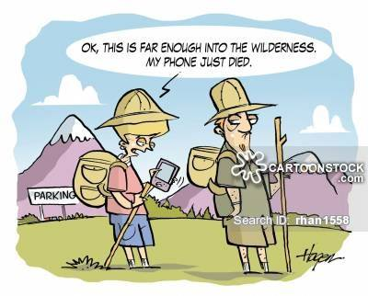
Discovering Outcomes that Matter to your Community?

Slide 29
*
OUTCOMES
Strategic Plan
Standards of Cover
Budget
Codes/Regs/Laws

Slide 30
Why Report Outcomes vs Outputs?
*
Outcomes are the only things that really matter to the community!!
Helps you sleep at night. (sometimes)

Slide 31

Outcomes
What’s in it for me (or my community)?
  How likely is my life, or the lives of my family, going to be saved?
  How much of my property will be saved (value, capabilities, can my business still operate, etc.)?
  What will be my quality of life?
  How much is this going to cost me if I support or don’t support my local fire agency? (Out of my pocket)

Slide 32
Outcomes
What’s in it for me (or my community)?
  Improved ISO rating to Class 2
  Lowered average fire insurance premium by $100 per year
  Improved Cardiac Survival rate from 20% to 40%
  Contained 84% of all residential structure fires to room of origin
  Saved 47 lives (plus 40 pets)

Slide 33
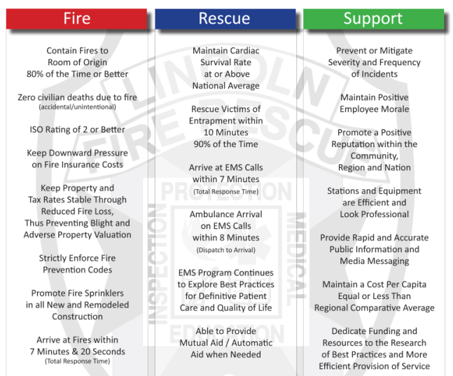

Slide 34
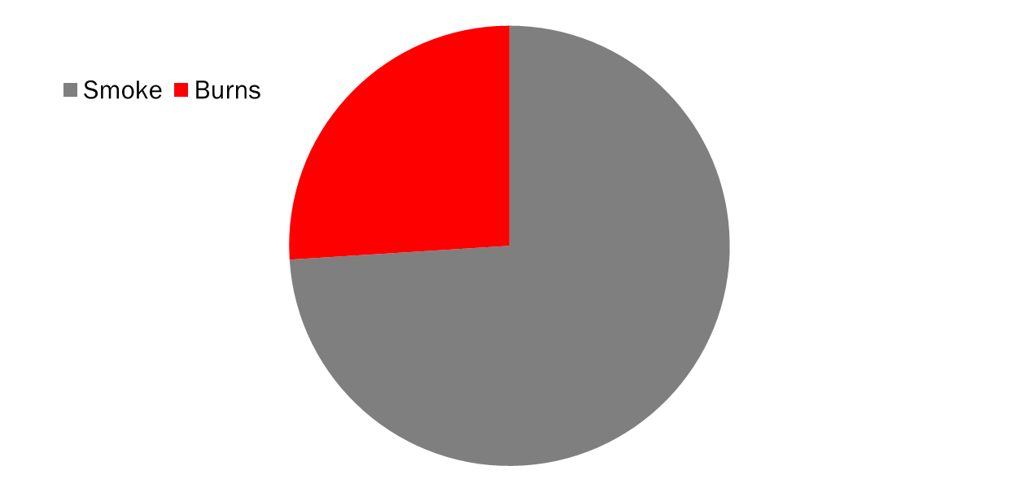
What Kills you First?
*
National Fire Protection Association – 2014

Slide 35
Chances of Injury or Death in a Home Fire
*
In Room of Origin
3%
Past Room of Origin
81%
NFPA Study -2009 to 2013:
2,600 fatalities and 13,000 injuries

Slide 36
How Much Would Being Displaced for a Year Cost You?
*
Original mortgage payment
The insurance deductible and any under-coverage costs
New cost of a rental and insurance
Moving costs
Work and school commutes
Lost financial records, taxes, ownership documents, etc.

Slide 37
*

Slide 38
Cost of Burn Injuries
*
One year in a Burn Center = $2.6 Million
Average Stay = 14 weeks ($700,000)
$7,000 day
Loss of income at work?
What is the cost of Pain and Suffering?
Notes:
Average stay is 14 weeks = $700,000

Slide 39
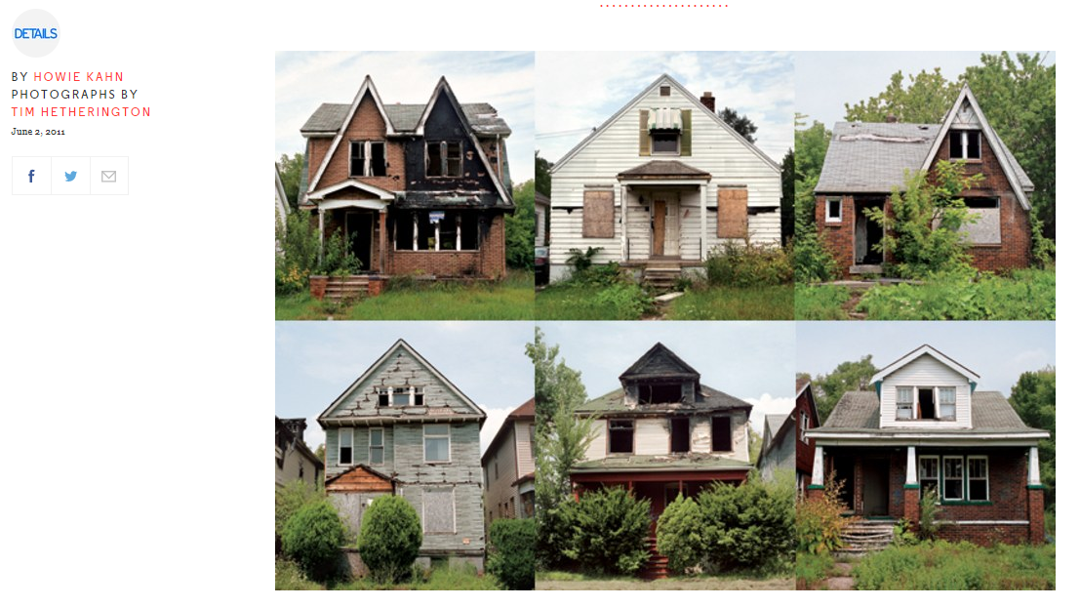
What is the economic impact of blighted structures?

Slide 40
All of this gets us to an Outcome:
Contain structure fires to room of origin 80% of time or better
Notes:
Average stay is 14 weeks = $700,000

Slide 41
EMS Outcomes
Maintain cardiac survival rate equal to or above national average
Rescue victims of entrapment within 10 minutes of notification, 90% of the time
ALS transport on scene within 8 minutes, 90% of the time

Slide 42
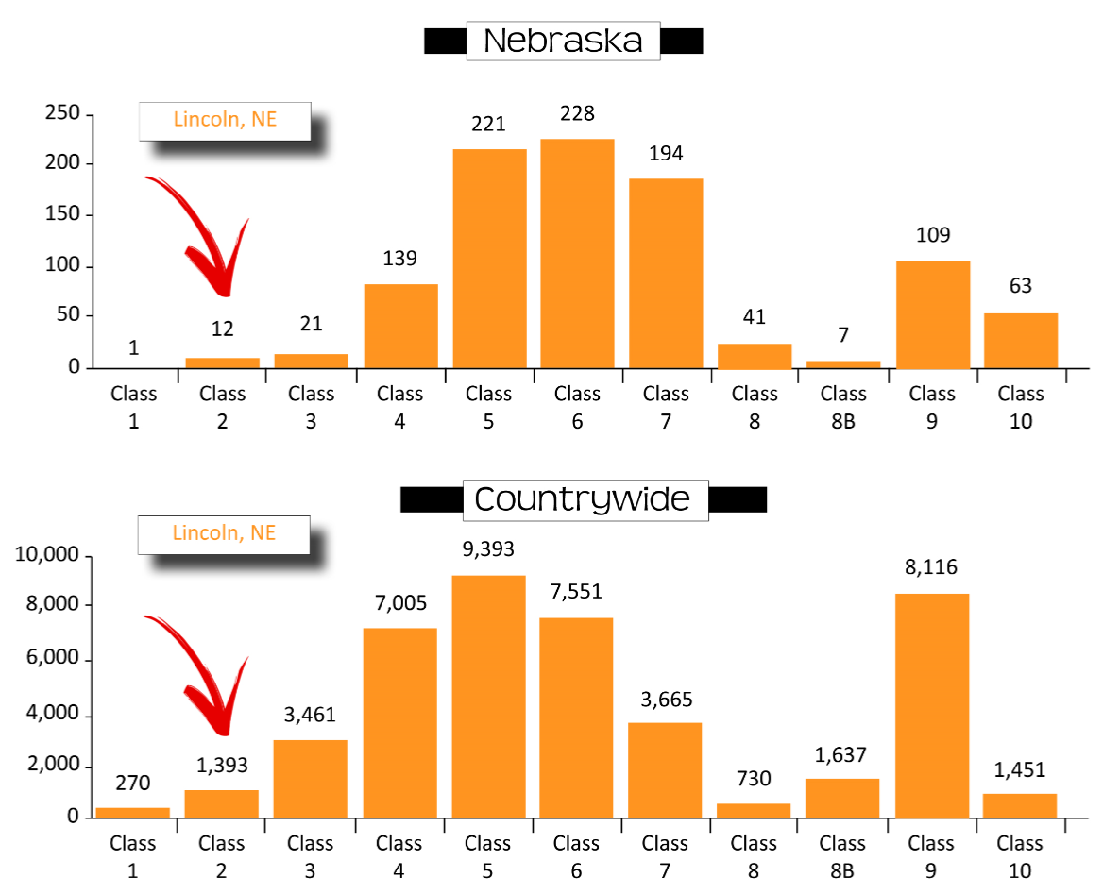

Slide 43
Keeping Insurance Rates Low
Source: Unico Insurance Feb 2017
Notes:
$96 savings ISO 3 to ISO 2

Slide 45
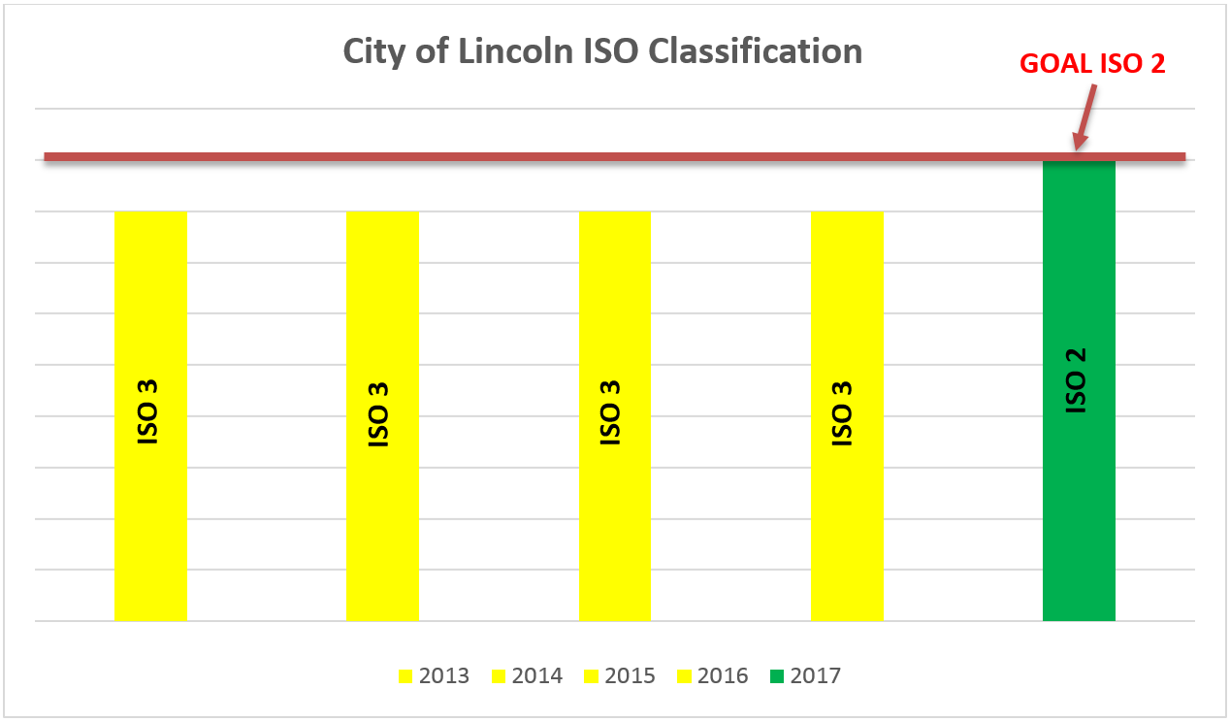
Show How you Save Taxpayers Money

Slide 46
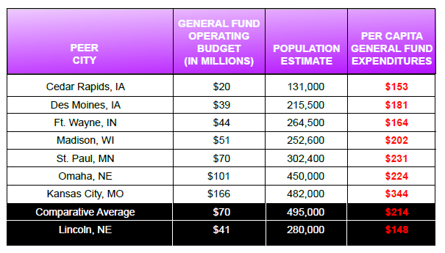

Slide 47
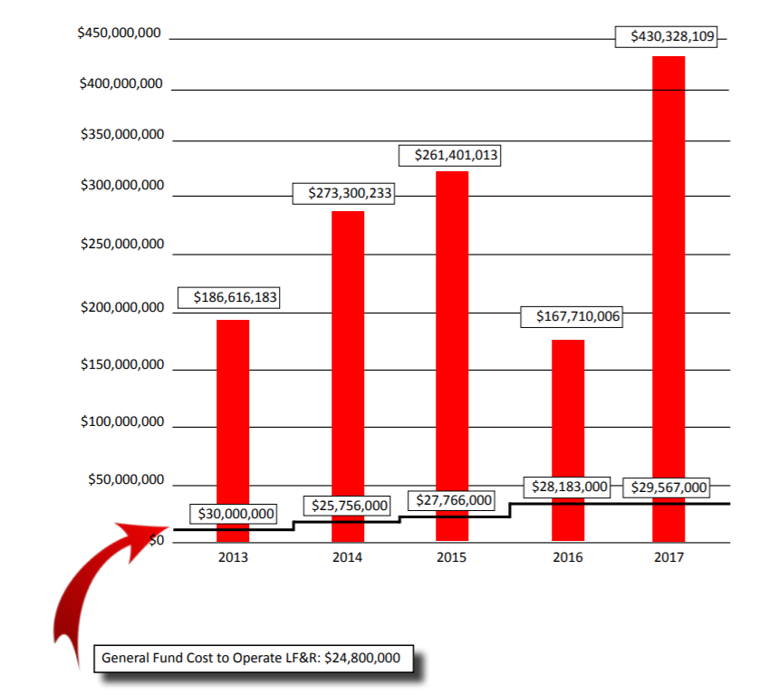
Does the fire dept. provide good value for my $?

Slide 48
How Much Does LF&R Cost me?
Ambulance Service = $0
Fire Services = $146 yr/pp
Regional Average = $216 yr/pp
National Average = $140 yr/pp

Slide 49
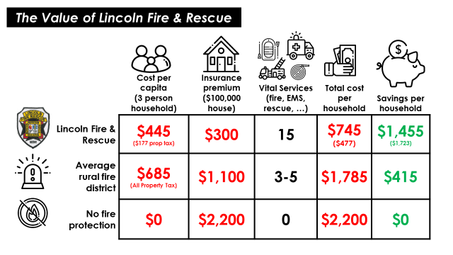

Slide 50
All of this gets us to an Outcome:
*
Maintain a Cost Per Capita equal to or less than the regional comparative average
Notes:
Average stay is 14 weeks = $700,000

Slide 51

Does your agency provide good value for the taxpayer’s money?
*

Slide 52
Where is your Wasted $$ Going?
*
Injury/sick leave - backfill
Injury treatment
Worker’s compensation annual expense
Lawsuits
Disciplinary processes
MORALE = MONEY

Slide 53
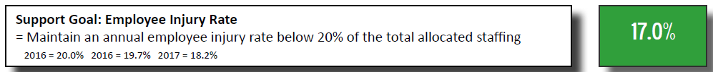
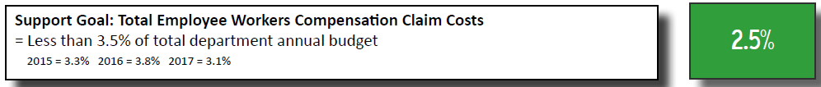
Where is your Wasted $$ Going?
*
*Could be 20% of total personnel and 3% of your annual personnel cost

Slide 54
EMS Outcomes
Maintain cardiac survival rate equal to or above national average
Rescue victims of entrapment within 10 minutes of notification, 90% of the time
ALS transport on scene within 8 minutes, 90% of the time

Slide 55
How You Present Outcomes and Data Matters
Remember, only a very small percentage will go past the first couple of pages.
Did you engage the reader to get your highlights early?
Does it tell a story easily?
Is the data you are showing relevant?
Is it easy to understand?

Slide 56
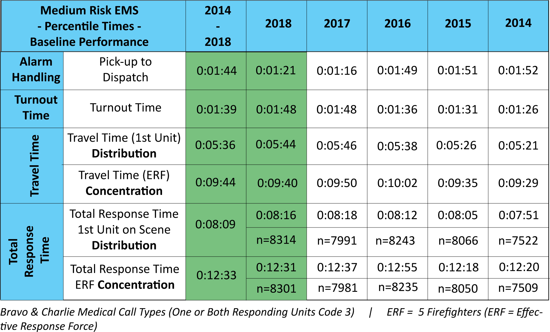

Slide 57
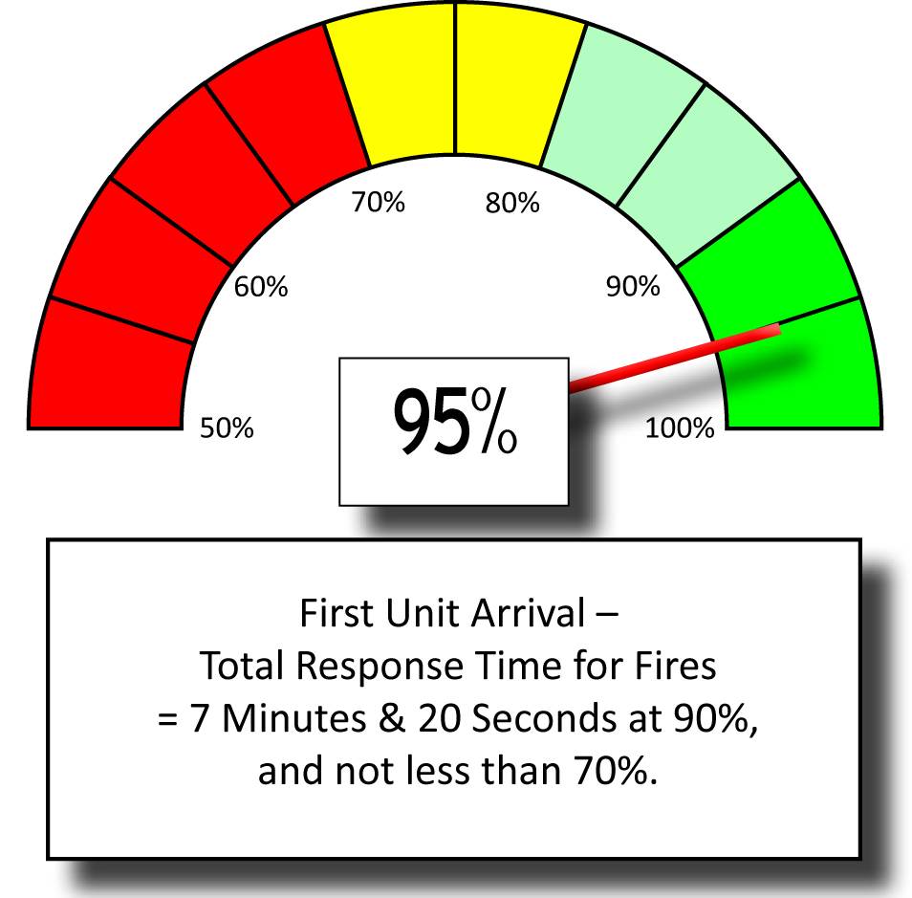
Does this make more sense to your community?

Slide 58
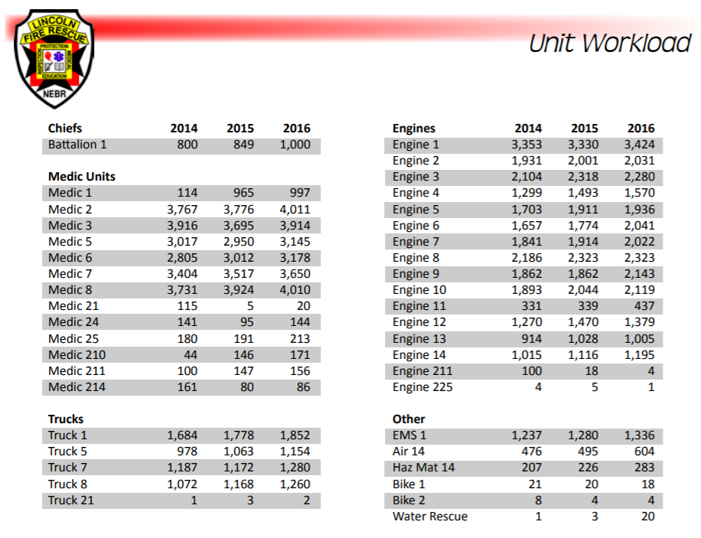

Slide 59
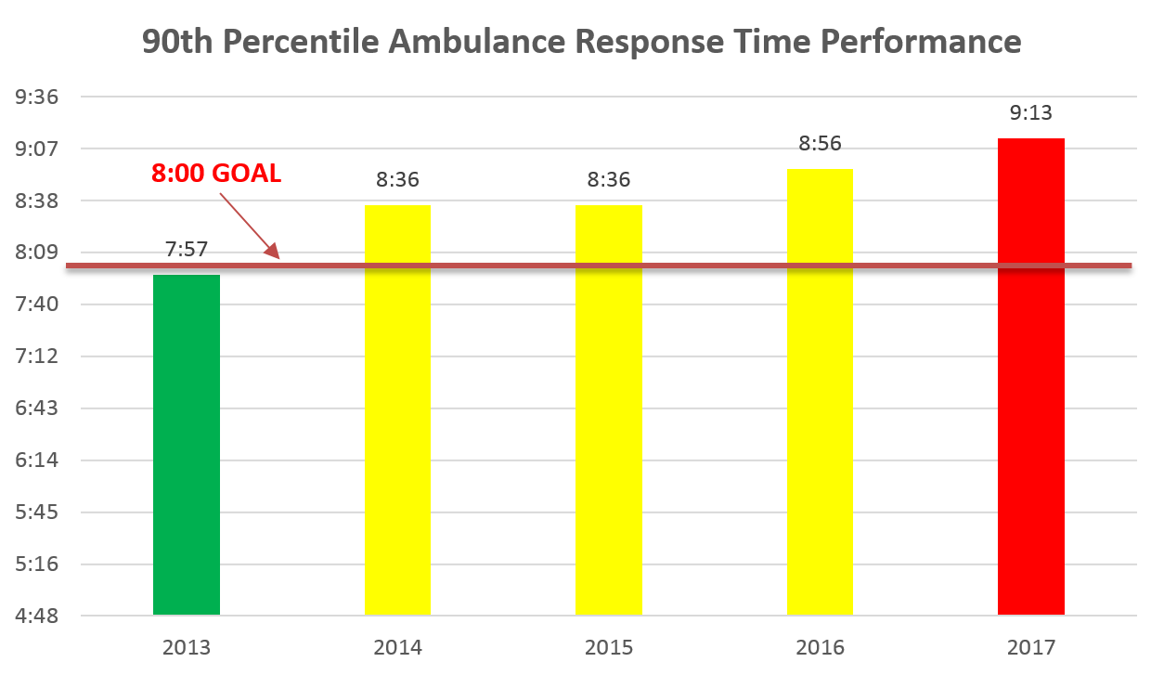
Telling the NOT SO GOOD Story
*
  Ambulances will have a total response time of 8 minutes or less 90% of the time to emergent medical incidents

Slide 60
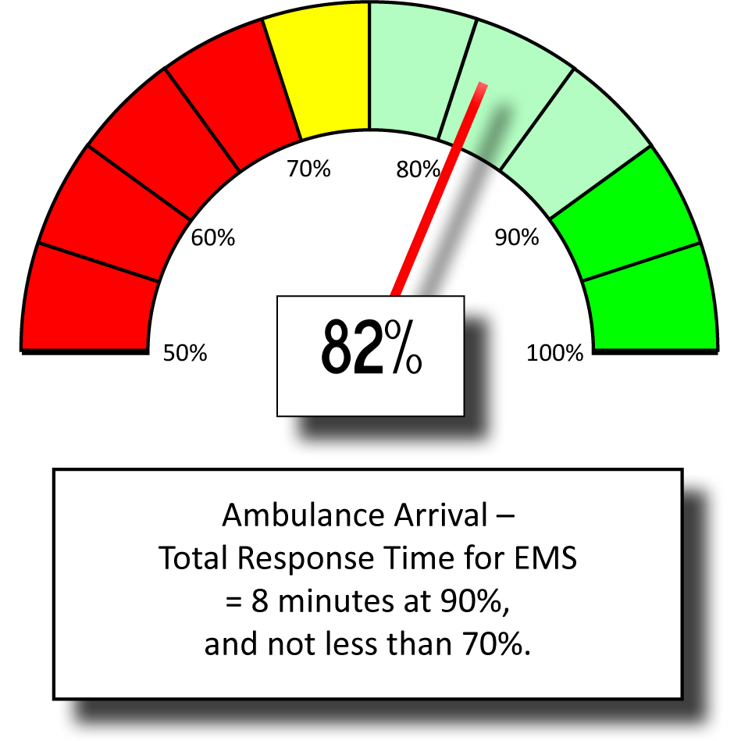

Slide 61
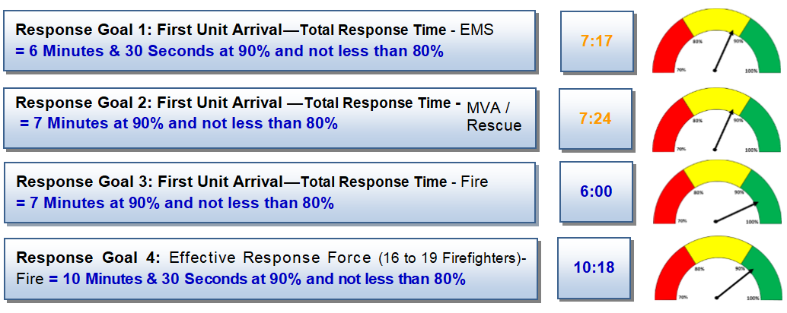
Does this make more sense to your community?

Slide 62
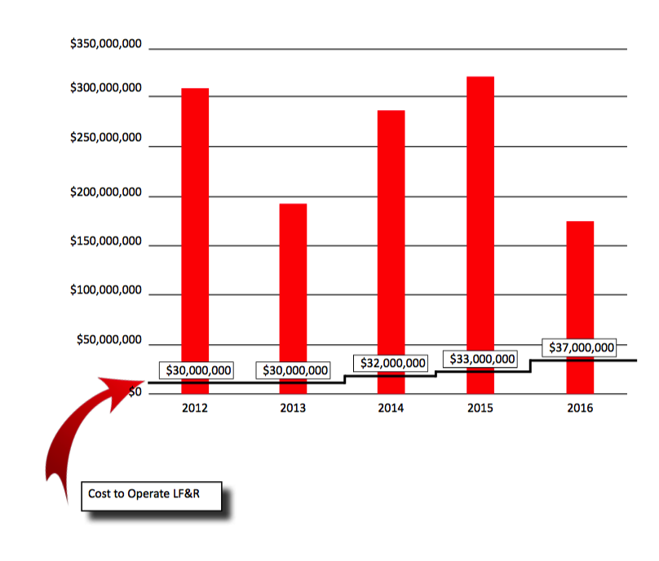
  LF&R will save/salvage property and contents which are lost to fire at a rate higher than the cost of annual operation.

Slide 63
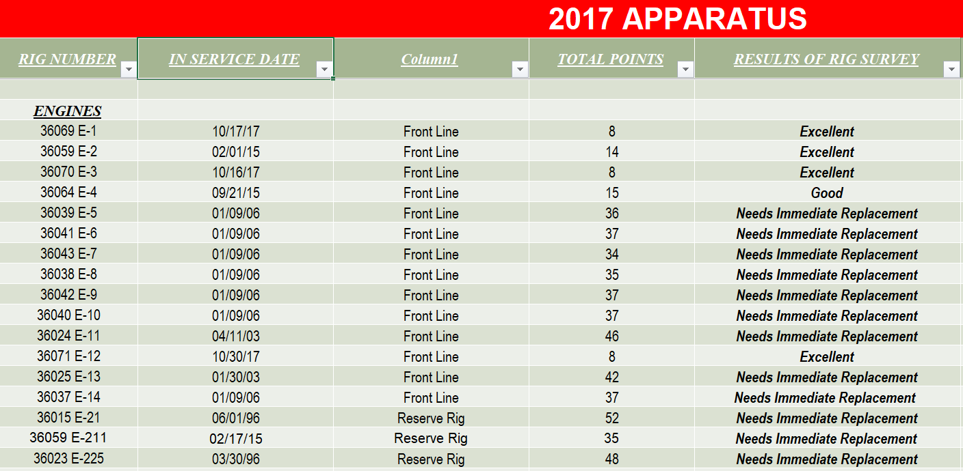

Slide 64
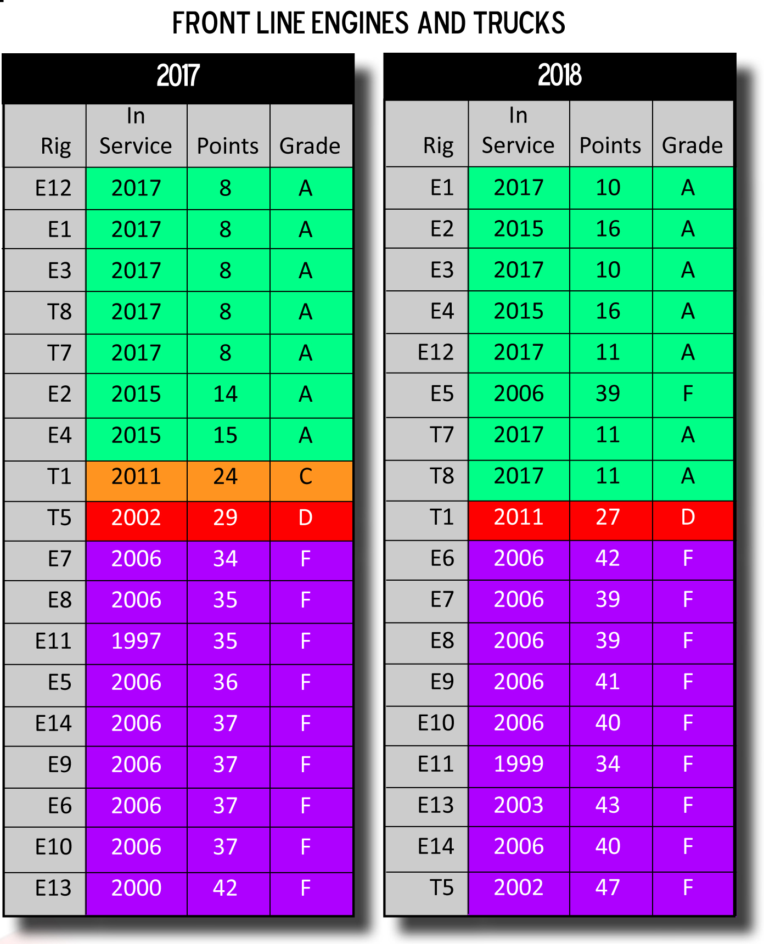
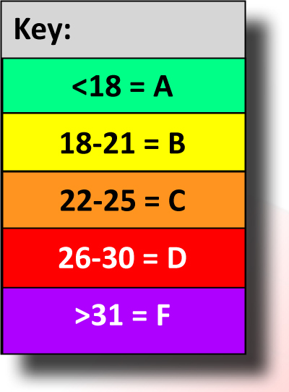

Slide 65
Civilian Lives Saved - 2017
Rescued – Fire | Survived
20 | 17

Slide 66
Pets Saved – 2017
Rescued – Fire | Survived
30 | 21

Slide 67
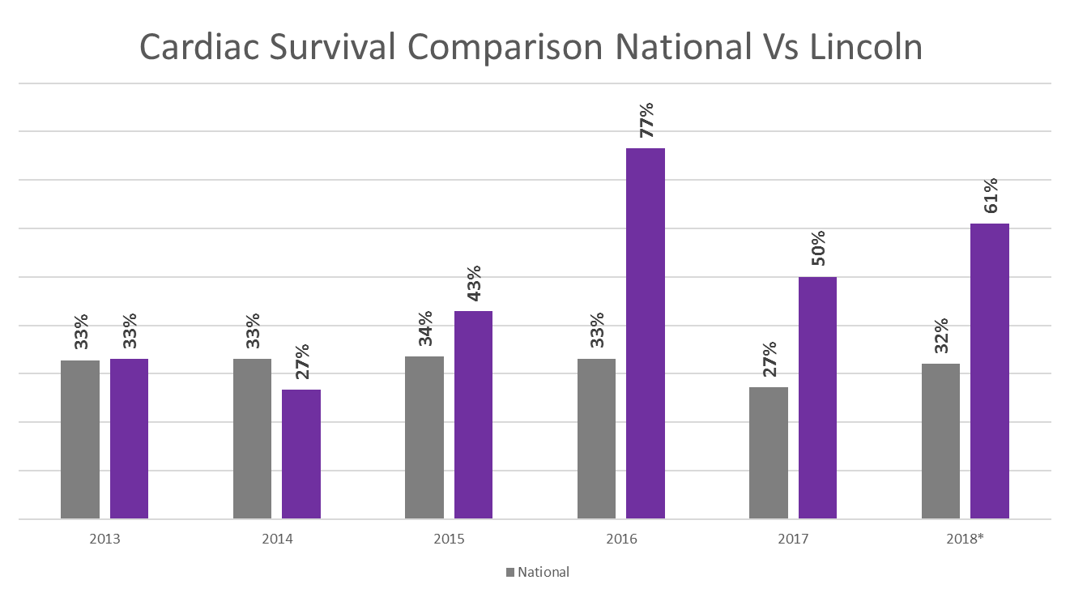

Slide 68
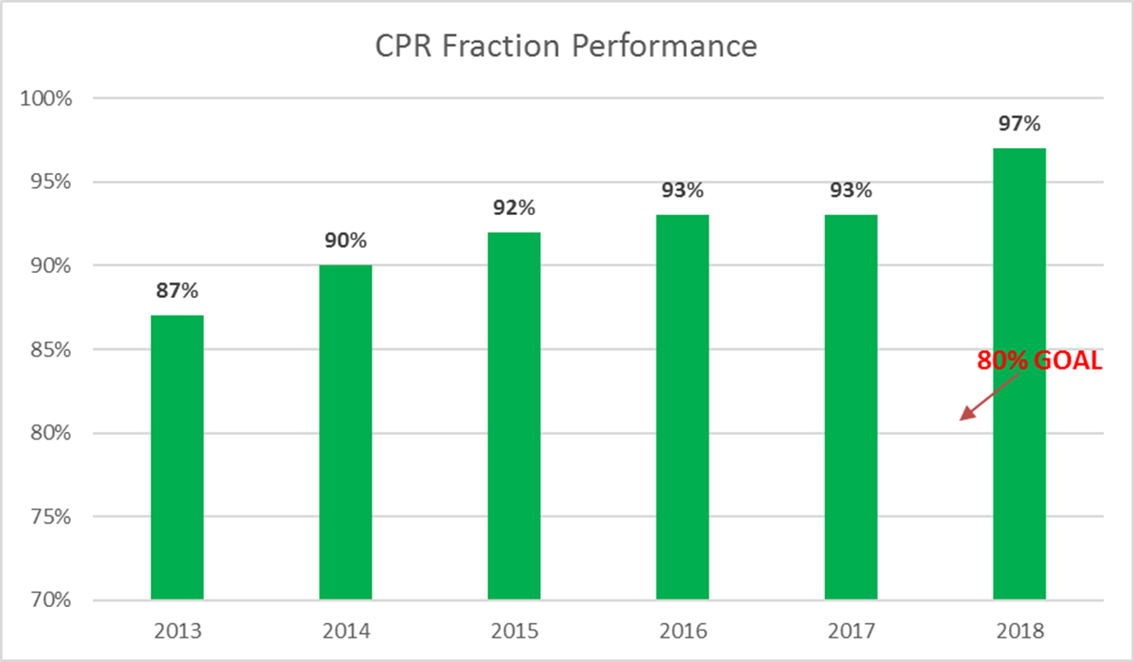
CPR Fraction
Achieve a CPR fraction of at least 80%

Slide 69
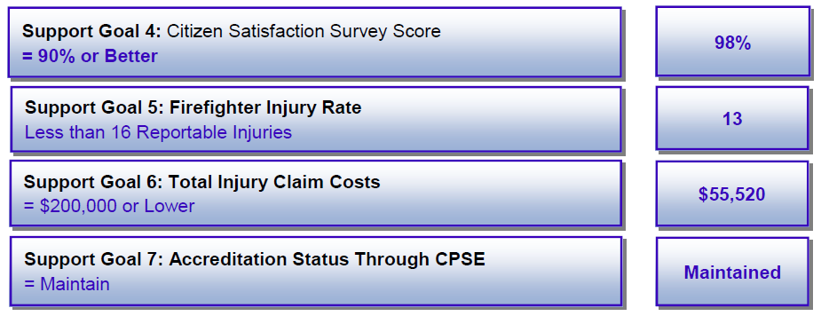

Slide 70

Maintain Accredited Status Through CPSE
YEAR | Maintained
2017 | YES
2016 | YES
2015 | YES
2014 | YES
2013 | YES
2012 | YES
2011 | YES
2010 | YES
2009 | YES
2008 | YES
2007 | YES

Slide 71
In Conclusion
Outcomes are the only thing that matters to your customers
Find out what Outcomes they actually value/want
Report out on the Outcomes that matter
Know your audience before you publish; some want more detail and some want less

Slide 72
Contact
John Binaski – johnbi@ci.clovis.ca.us
  559-324-2260

