Slide 1
Addressing Workplace Bullying from a Witness Perspective
Dr. Sabrina B. Ricks
The Chicago School of Professional Psychology
DC Campus

Slide 2
Objectives/Topics of Discussion
Why do I care about bullying?
  My personal experience
What is workplace bullying?
The forerunner
The law
Dr. Ricks’ research – How bullying affects witnesses
Generalizations and practical implications
What the future holds…

Slide 3


Slide 4


My Experience

Slide 5
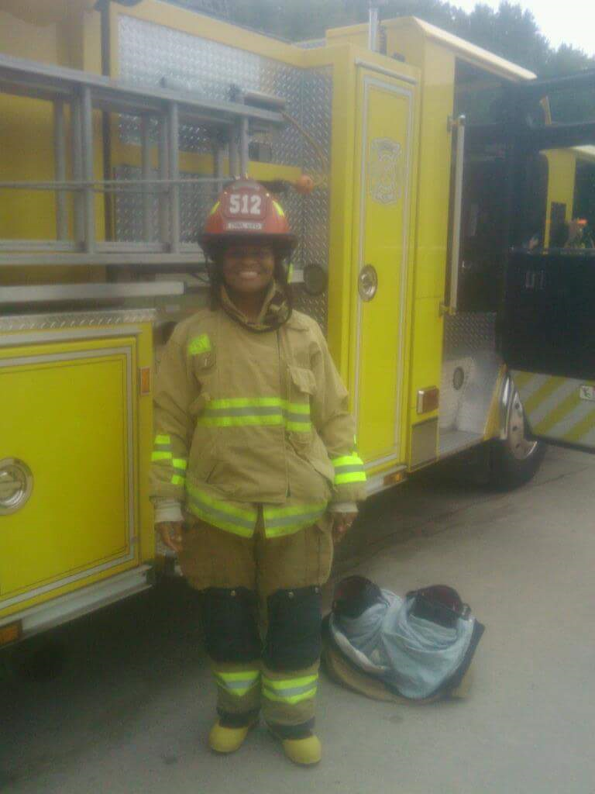
My Story
Lt. Tammy – supervisor
Ambulance driver
Completed EMT school
Promotion attempt
Breaking point – Unit checkout/the call
Request to move

Slide 6

What does workplace bullying look like?

Slide 7

Forerunner: Andrea Adams (1992)

Slide 8

Workplace Bullying
Workplace bullying is defined as repeated mistreatment of an employee that includes social exclusion, isolation, not greeting, ignoring the victim’s presence, humiliation, demeaning, belittling, excessive deadlines, excessive monitoring of work, few or no tasks, threats, insults, and criticisms, all which may lead to high levels of stress and other health endangering factors. This definition does not include physical abuse (Ricks, 2015)

Slide 9
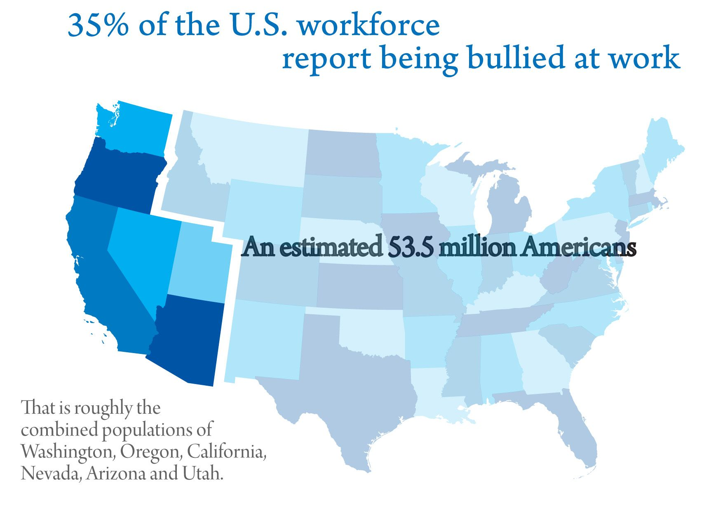
(WBI, 2018)

Slide 10

The Law
Harassment/Discrimination IS protected
  i.e. race, color, national origin, religion, sex, age, or disability
Workplace bullying is NOT directly protected
Cyberbullying – bullying via electronic communication
  State laws passed for protection for grade school individuals
  (Georgakopoulos, Wilkin, & Kent, 2011)

Slide 11

Statistics/Literature Turning My Attention to Witnesses

Slide 12

Witnessing Workplace Bullying
2nd most affected individual of workplace bullying
Observer who is exposed to bullying but not the direct target
(Hoel & Cooper, 2000)

Slide 13
Statistics/Literature Turning My Attention to Witnesses
Oladapo & Banks (2013) Study
  24 interviews
  779 employee engagement surveys
    47% of participants bullied at some point
    75% had witnessed bullying of a coworker
    27% had been bullied directly within the last 12 months
1 in 5 workers report having witnessed workplace bullying and finding the work environment unsafe (Rayner, 1999)
70% of jobs/careers are in the service sector (Yamada, 2000)

Slide 14
Additional Literature Turning My Attention to Witnesses
Bullying is unethical & unnatural (Einarsen, Hoel, Sapf, & Cooper, 2011)
Issues with safety as well as work related illnesses arise (Carden & Boyd, 2013 & Adams, 1992)
Learning more about witness perspectives of workplace bullying could add to the body of knowledge, but a how-to guide may better help address the issue...(Mathison, Einarsen, & Mykleton, 2011)

Slide 15

My Research: Organizational Culture, Leadership, & Unsafe Environments

Slide 16
My Research: Organizational Culture, Leadership, & Unsafe Environments Conceptual Framework
Leadership
Workplace Bullying
Organizational Culture
Target/Witness
Perception of an Unsafe Environment

Slide 17
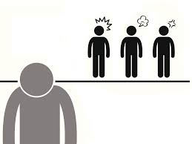
My Study: Research Problem
Bullying is occurring in organizations throughout the United States and there are victims and witnesses.

Slide 18

My Study: Research Question
How did witnesses perceive and describe their experiences of organizational culture and leadership regarding U.S. workplace bullying and unsafe environments?

Slide 19
Description of the Study
Phenomenological study
Population – Closed, online, social media site, female
Sample – 14 participants – Saturation reached
Data collection – Semi-structured telephone interviews
  Interview guide was divided into sections that covered demographics, workplace bullying, leadership, organizational culture, and unsafe environments, respectively
Data analysis – modification of van Kaam method of analysis of phenomenological data (Moustakas, 1994)

Slide 20
Data Collection – Interview Questions
Demographics
Workplace Bullying
  Describe the scenario you witnessed
Leadership
  What did you see and hear?
  Actions you considered or took?
Organizational Culture
  Assumptions, beliefs, values, and artifacts (Schein, 2004)
Additional information

Slide 21
Verbatim Response to Question About Organizational Culture
“Well, you are very unproductive . . . your job performance is greatly affected and not just the person that is being bullied but also the witnesses, like myself. Your job performance is gravely affected so you are not going to be able to be as productive at work at all. Also, the person that is being bullied it is not going to be productive at work so everything is counterproductive when this is happening. It’s just a horrible, horrible, horrible situation to be in. Like I said before, fortunately I was able to leave, but not everybody is as fortunate as I was . . . so I’m hoping that more things are being put into place to address it so that, you know, like the person that is being bullied feels like they have somewhere to go complain because of the situation . . . it was, then it is very difficult because of a relationship, it is very difficult to prove the supervisor and the employee . . . that is just so hard to prove it.”

Slide 22
Verbatim Response to a Question Concerning Actions They Had Taken Toward the Bully
“At that time, I felt like I might’ve should’ve talked to the employee to let her know, you know, don’t let it affect you, as far as the management position goes. I don’t really feel like, at that point . . . I don’t feel like I should have said anything to her because that would put my job in jeopardy, you know. Well obviously she was already a loose cannon or had some issues going on and I didn’t want to put myself in a predicament to get fired, or wrote up behind speaking with her.”

Slide 23
Data Analysis
The Modification of the van Kaam Method of Analysis of Phenomenological Data (Moustakas, 1994, p. 120)
  List and group to horizonalize data
  Reduce and eliminate constituencies
  Cluster invariant constituents into groups and themes
  Final identification of invariant constituents and themes (validation)
  Individual textural descriptions
  Individual structural descriptions
  Composite textural-structural descriptions
  Synthesis of meanings and essences
  Moustakas, 1994, p. 120-121

Slide 24
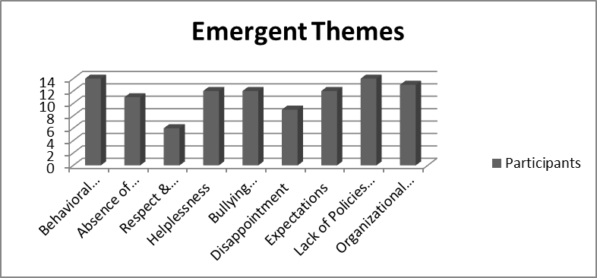
Findings
Bullying behaviors
Absence of leadership
Respect & disrespect
Helplessness
Unresolved bullying
Disappointment
Expectation of values
Lack of policies & procedures
Organizational awareness

Slide 25

#1 Bullying Behaviors (14)
Yelling
Humiliation
Ridicule
Blatant demeaning
Ostracized
Ignored
Excessive deadlines
Teasing
Foul language
Insulting
Attacking
Excluded
Threatened
Name calling
Required to work extra hours

Slide 26

#2 Absence of Leadership (11)
Contacted individuals in leadership and received no response
Leadership was present in some circumstances and did nothing
  “…the president of the company was present for a couple of the bullying incidents and nothing was done about it”
Some felt that leaders laughed and participated in the bullying

Slide 27
#3 Respect & Disrespect (6)
Participants felt you would be respected when you begin working for any organization
Many were surprised to learn that disrespect was acceptable
  Some of them felt disrespected that they had to be exposed to (witness) workplace bullying at all
“Most people assume when they go to work they’re going to be treated with respect by their coworkers, by their manager and I didn’t think this would be any different from any other [workplace].”

Slide 28

#4 Helplessness (12)
In many cases, the participant wanted to confront the bully and was afraid, thus feeling helpless
  “I voiced my feelings to a few individuals and my frustration, but in the end decided not to say more because of who the person was. I decided there was really not much that I could do.”
One participant felt human resources could not or would not help them because the bully had too much power

Slide 29
#5 Unresolved Bullying (12)
Expressions that the organizational culture was not one of resolving conflict/issues
Even when the victim left the organization, many participants felt the culture remained the same
  One that allowed workplace bullying
One participant stated management was “lackadaisical on it. I don’t think they enforced things the way they should.”

Slide 30
#6 Disappointment (9)
Many participants expressed disappointment that they had to be exposed to an unsafe/unhealthy work environment
  Unfair
One participant did not think others cared that there were bullies in the organization
Some expressed disappointment that there was no way to remedy the situation
  No discipline and no actions taken to address the bully

Slide 31
#7 Expectations of Value (12)
Many participants expected they would be a valued employee
Expected policies and procedures to keep the environment safe, fair, and comfortable
One participant statement:
  “…things I saw, just led me to believe that there is a lot of talk and not as much focus on some of these core values . . . the team members specifically. But while we are presented as a priority sometimes that it’s not always the case, you know, despite the greatest efforts of the overall organization.”

Slide 32

#8 Lack of Policies & Procedures (14)
Participants received an employee handbook upon hire and/or orientation
  No policies and/or procedures where workplace bullying is mentioned
They had no idea what to do in the event they were bullied or witnessed someone being bullied

Slide 33
#9 Organizational Awareness (13)
On a broad level, most participants stated they did not feel the organizational leaders at the upper echelon were even aware of the bullying taking place or cared
They felt awareness is important
  One participant described the upper echelon as selfish and only thinking about their role in the organization and the bottom line
  “I felt a little bit unsafe and unsure of the job, you know . . . anyone can talk to you anyway they would like.”
There were additional comments regarding helplessness and disappointment due to this issue with lack of organizational awareness

Slide 34

Now what?
Learning more about witness perspectives of workplace bullying could add to the body of knowledge, but a how-to guide may better help address the issue...
(Mathison, Einarsen, & Mykleton, 2011)

Slide 35
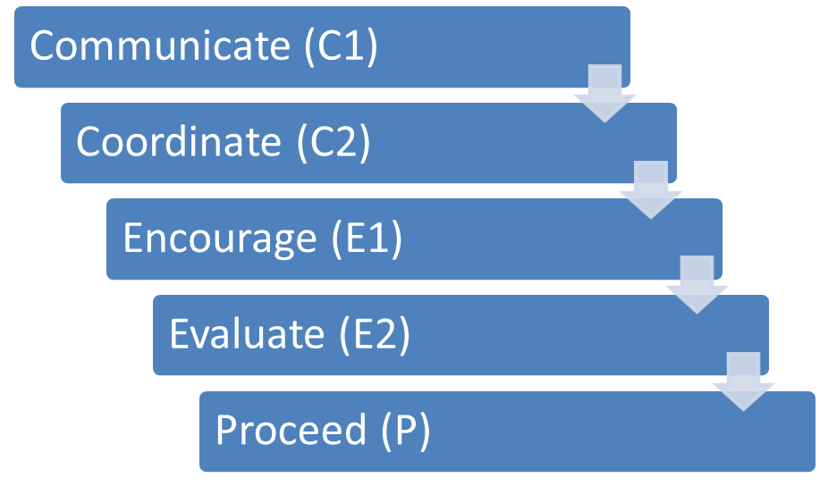
C2E2P Model

Slide 36

Communication (C1)
Share what you have witnessed and offer to help
Encourage communication between bully and target
Offer to serve as a mediator
If comfortable, offer to speak on target’s behalf

Slide 37

Coordinate (C2)
Help target coordinate with a trusted resource connected to the organization
  Human resources
  Employee assistance program (EAP)
  Union
  Employee assistance hotline (anonymous)

Slide 38

Encourage (E1)
Investigations can be lengthy
The target should not feel isolated during this process
  Bullying may still be occurring
  The environment may still feel hostile
The witness should continue to be supportive, friendly, and approachable

Slide 39

Evaluate (E2)
Once the target gets a result, how do they feel?
  Was the situation addressed? Resolved? Fair?
  Are they happy with the final decision?
  Unresolved? No follow up? (after 30 days)
If the target is satisfied with the results, the process could end here

Slide 40
Proceed (P)
If the target is dissatisfied with the results of the bullying investigation, proceed to seek help outside of the organization
  Equal Employment Opportunity Commission (EEOC)
  Occupational Safety and Health Administration (OSHA)
  Labor law firm/lawyer
  Local agencies

Slide 41
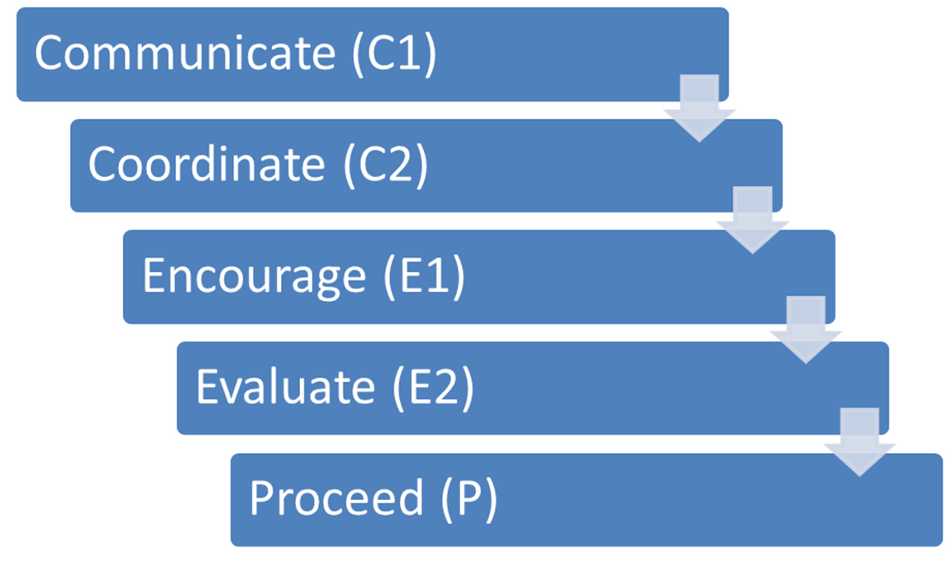
How the C2E2P Model Can Make a Difference
The C2E2P model could have a positive impact on organizations to minimize or eliminate workplace bullying.
More organizational awareness of workplace bullying throughout the U.S. could also minimize or eliminate workplace bullying.
This research could serve as a guide for organizations that have already identified many, specific areas that need to be addressed to make positive change.

Slide 42


What the Future Holds…

Slide 43
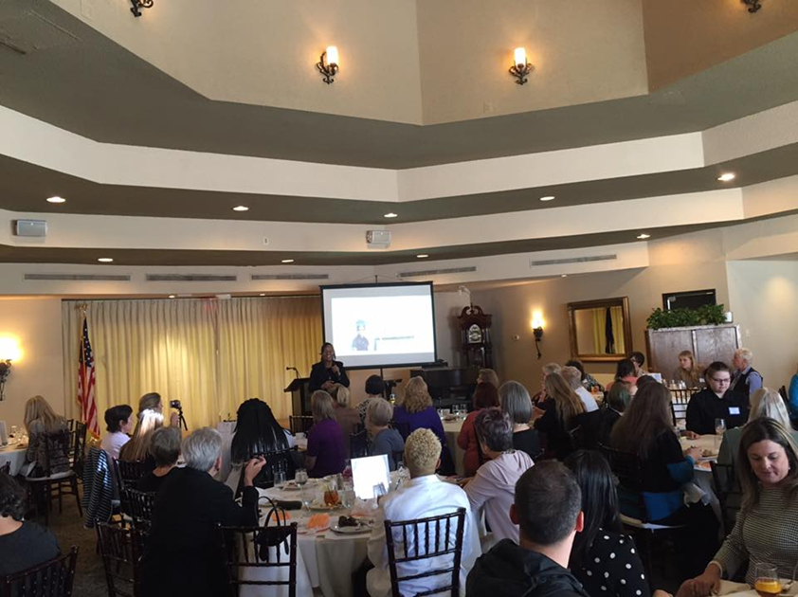

My Company
Assessments of the organizational culture
Trainings with managers and/or employees
  Workplace bullying
  Teamwork
  Leadership
  Management
  Diversity
  Appreciation

Slide 44

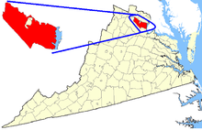


Primary Harassment/Bullying Prevention Instructor

Slide 45


International Association of Fire Chiefs
Bullying, Harassment, and Violence Prevention Task Force
Launching nationwide training mid-2019

Slide 46
Practical Managerial & Leadership Implications
Educating all employees of potential challenges/issues
Establishing departments for conflict resolution
Implementing policies & procedures
Hiring workplace consultation company
Initial training/orientation
Updates/refreshers
Employee opinion surveys
SBR Workplace Consultation Services

Slide 47
Safe & Inclusive Work Environments
Ensure respect is given and received
Find and keep the right people
Take care of yourself - personal health and work/life balance
Employee motivation
Make the most of meetings to support company goals/objectives
Lead by example
Foster an atmosphere of teamwork and dedication
Overcoming stress
Coaching/Feedback

Slide 48
More Work to be Done…
Psychological-Emotional-Mental Injuries from Workplace Bullying
Debilitating Anxiety (80%)
Panic Attacks (52%)
Clinical Depression: new to person or exacerbated condition previously controlled (49%)
Post-traumatic Stress (PTSD) from deliberate human-inflicted abuse (30%)
Shame (the desired result of humiliating tactics by the bully) - sense of deserving a bad fate
Guilt (for having "allowed" the bully to control you)
Overwhelming sense of Injustice (Equity - the unfairness of targeting you who works so hard; Procedural - the inadequacy of the employer's response to your complaint)
(Directly from WBI Site, 2018)

Slide 49

Future Research
  Locations
  Gender
  Coworker bullying
  Subordinate to manager
  Safe environments
  Good leadership

Slide 50
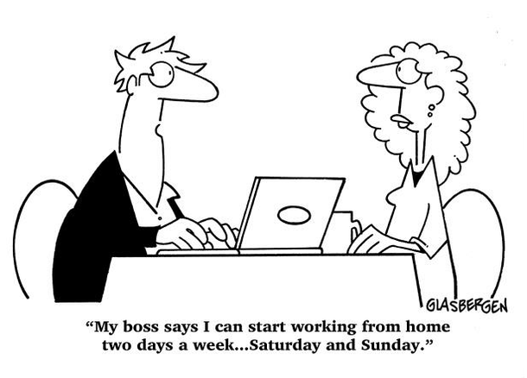
Culture: Quote
“People don’t work for companies just to earn a paycheck. They want to feel good about the companies they work for and they want to feel like they’re making a difference in the world.”
Ron Sargent, Chairman and CEO, Staples, Inc.

Slide 51

Thank You!

Slide 52
References
Adams, A. (1992). Bullying at Work: How to Confront and Overcome It. Virago Press: London, United Kingdom.
Carden, L., & Boyd, R. (2013). Workplace bullying: Utilizing a risk management framework to address bullying in the workplace. Southern Journal of Business & Ethics, 5, 8-17.
Georgakopoulos, A., Wilkin, L., & Kent, B. (2011). Workplace bullying: A complex problem in contemporary organizations. International Journal of Business and Social Science. 2(3), 1-20.
Hoel, H., & Cooper, C. L. (2000). Destructive conflict and bullying at work. Manchester, England: University of Manchester Institute of Science and Technology.
Mathisen, G. E., Einarsen, S., & Mykletun, R. (2011). The relationship between supervisor personality, supervisors’ perceived stress and workplace bullying. Journal of Business Ethics, 99, 637-651.
Moustakas, C. (1994). Phenomenological Research Methods. Thousand Oaks, CA: Sage.
Oladapo, V., & Banks, L. T. (2013). Management bullies: The effect on employees. Journal of Business Studies Quarterly, 4(4), 107-120.

Slide 53
References
Rayner, N. A. (1999). From research to implementation: Finding leverage for prevention. International Journal of Manpower, 20, 28-38.
Ricks, S. B. (2015). Witnesses of U.S. workplace bullying: A phenomenological study of organizational culture, leadership, and unsafe environments. Ann Arbor, MI: ProQuest Dissertation Publishing.
Schein, E. H. (2004). Organizational culture and leadership. San Francisco, CA: Jossey-Bass.
U.S. Department of Justice (2016). Workplace violence: Issues in response. Retrieved from file:///C:/Users/kbricks/Downloads/workplace_violence%20(1).pdf
Workplace Bullying Institute (2018). To research and understand, to educate the public, & to teach prevention & Correction of abusive conduct at work. Retrieved from http://www.workplacebullying.org/
Yamada, D. C. (2000). The phenomenon of “workplace bullying” and the need for status-blind hostile work environment protection. Georgetown Law Journal, 88(3), 475-536.

